Slide 1
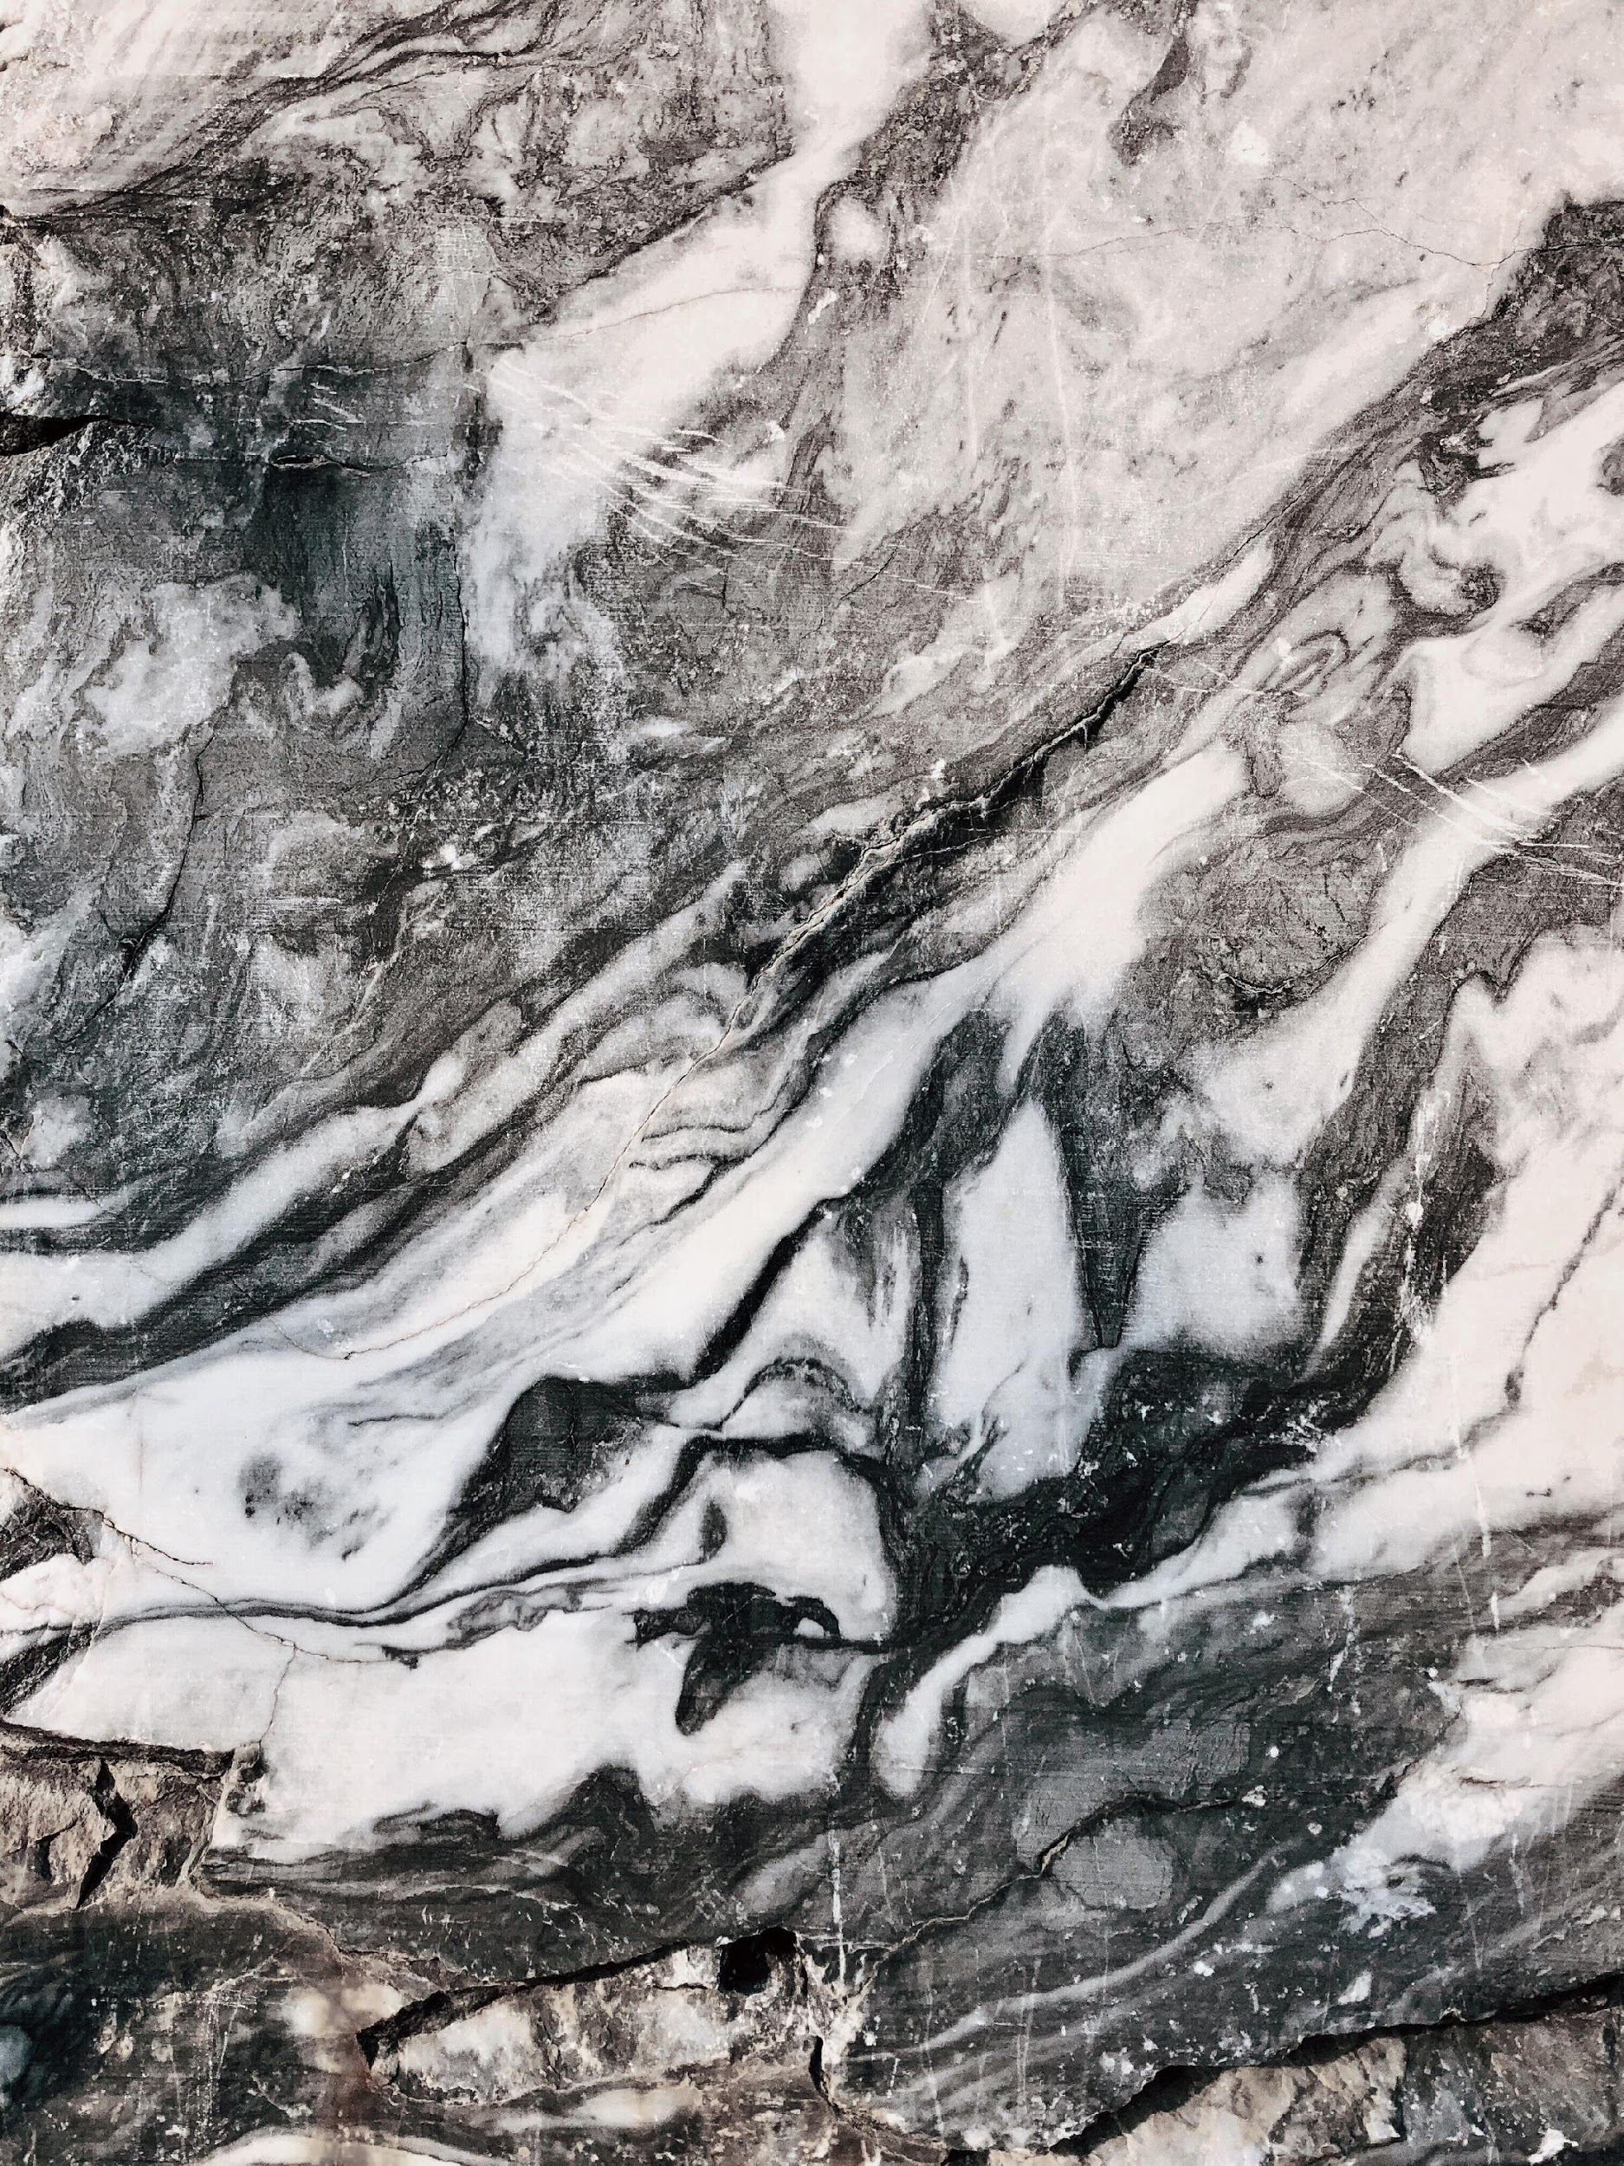
Automatic Detection of Key frame and Motion frame in Bharatanatyam Video
Heeramani Prasad
15CS30015
hmp68239@gmail.com
Master Thesis Project
Guided by: Prof. Partha Pratim Das
Mentored by: Himadri B.G.S. Bhuyan
Department of Computer Science and Engineering
Indian Institute of Technology, Kharagpur

Slide 2
Master Thesis Project
Introduction
Problem Motivation
Literature Survey
Project Objective
Workflow
Preprocessing
Possible approaches
Dataset Introduction
Experimental Results
Conclusion
Acknowledgement
References
Presentation Highlights

Slide 3
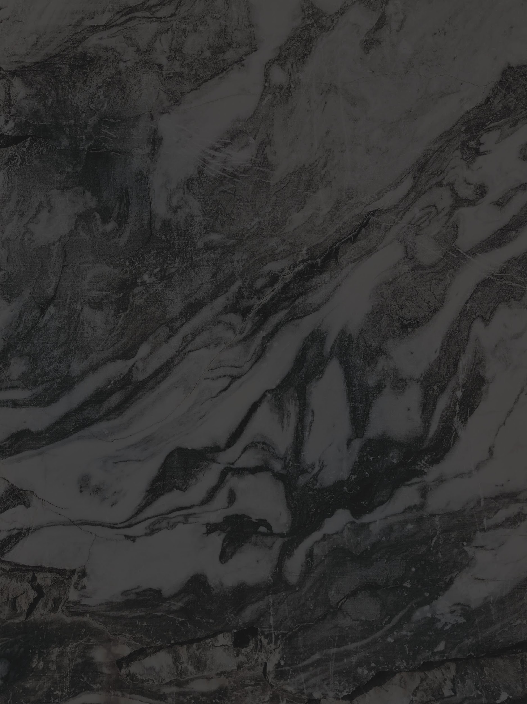
Terminology Associated with Bharatanatyam Dance
Adavu: Basic unit of Bharatanatyam
Key Postures: Momentarily stationary well-defined postures occurs within the Adavu
Key Frames: Frames associated with a key posture
Motion Frames: Frames associated with motion

Slide 4
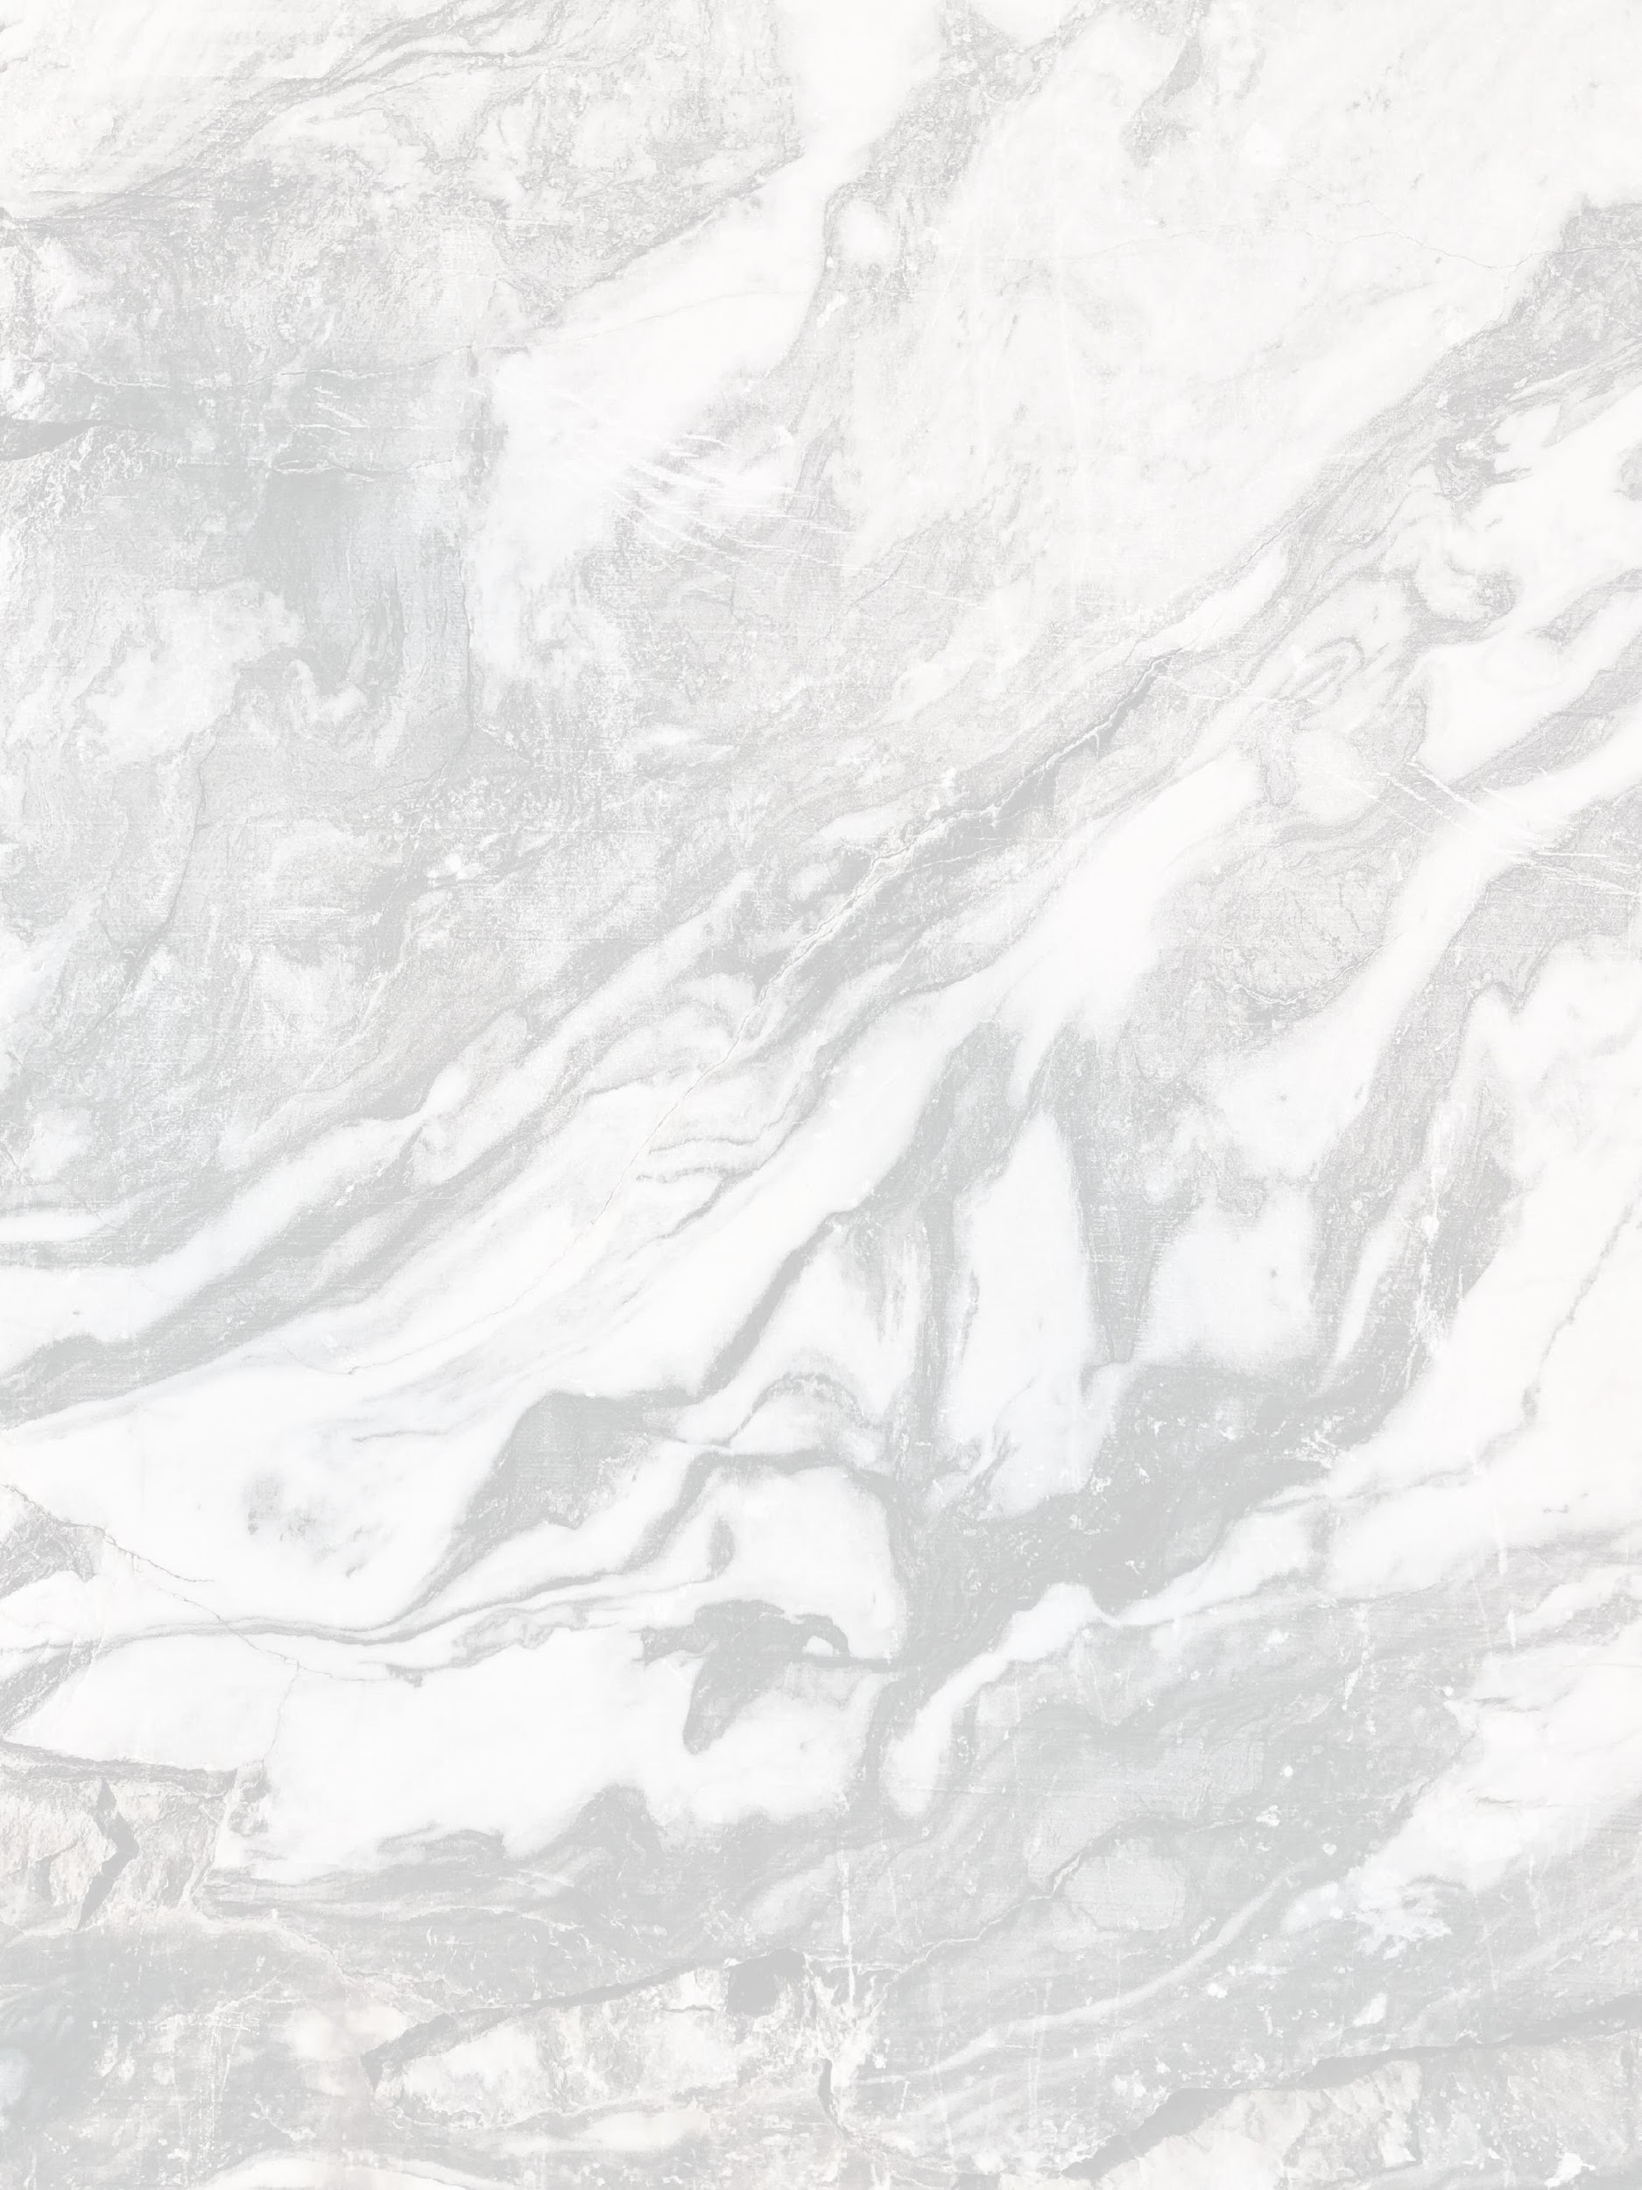
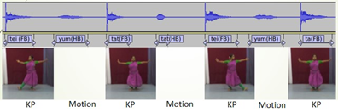
Introduction to Key frame and motion frame in Bharatanatyam
Figure: Occurrence of Motion and KPs
Key Posture(KP): Momentarily stationary well-defined postures occurs within the Adavu
Key Frames: Frames associated with a key posture
Motion(M): A motion is a transition from one key posture to the next key posture
Motions (M) and key postures (KP) occur alternately and may repeat in a performance
Performance P consists of the interleaving sequence given by K1 M1 K2 M2 K3 M3 ... K(n-1) M(n-1) Kn.
A motion comprises of several set of frames those are not momentarily stationary.

Slide 5
Literature Survey
Tanwi Mallick et al. develop Nritya Guru – an autonomous coaching system to give real-time instructional feedback regarding the accuracy of Bharatanatyam as performed by a learner.
Matthew Cooper et al. presented approach on temporal video segmentation using supervised machine learning classification. They have created standard features through pairwise similarity of images.
Rizwan Chaudhry et al. suggested a method for representing every frame of a video using a Histogram of oriented optical flow (HOOF).
By Laptev, Local histogram approaches were used for local spatiotemporal characteristics or feature for representing human activity in a video.
Optical flow histograms were applied to match the movement(motion) of a player in a soccer match to that of a subject in a control video.
Guozhu Liu at el. showed Key Frame Extraction method from compressed MPEG video data.
Konečný used RGB, depth images and combine appearance (Histograms of Oriented Gradients) and motion descriptors (Histogram of optical flow) for parallel temporal segmentation and recognition.
Tran et al. present an optical flow and shape-based approach that uses separate histograms for the horizontal and vertical components of the optical flow as well as the contour of the person as a motion descriptor.
Aich, A., Mallick, T., Bhuyan, H.B., Das, P.P. and Majumdar, A.K., 2017, December. Nrityaguru: A dance tutoring system for bharatanatyam using kinect. In National Conference on Computer Vision, Pattern Recognition, Image Processing, and Graphics (pp. 481-493). Springer, Singapore.
Matthew Cooper, Ting Liu, and Eleanor Rieffel. Video segmentation via temporal pattern classification. IEEE transactions on multimedia, 9(3):610–618, 2007.
Rizwan Chaudhry, Avinash Ravichandran, Gregory Hager, and Ren´e Vidal. Histograms of oriented optical flow and binet-cauchy kernels on nonlinear dynamical systems for the recognition of human actions. In 2009 IEEE Conference on Computer Vision and Pattern Recognition, pages 1932–1939. IEEE, 2009
Ivan Laptev. On space-time interest points. International journal of computer vision, 64(2-3):107–123, 2005
. Alexei A Efros, Alexander C Berg, Greg Mori, and Jitendra Malik. Recognizing action at a distance. In null, page 726. IEEE, 2003.
Guozhu Liu at el. showed Key Frame Extraction method from compressed MPEG video data. It helps in reducing Video processing time significantly.It helps in video segmentation and Keyframe extraction. [Liu and Zhao, 2010].
Koneˇcn´y, J. and Hagara, M used RGB, depth images and combine appearance (Histograms of Oriented Gradients) and motion descriptors (Histogram of optical flow) for parallel temporal segmentation and recognition. [Koneˇcn`y and Hagara, 2014].
Tran et al. present an optical flow and shape-based approach that uses separate histograms for the horizontal and vertical components of the optical flow as well as the contour of the person as a motion descriptor. [Tran and Sorokin, 2008]

Slide 6
Problem Motivation & Challenges
Motivation
Motivation 1:
Distinguish keyframe to motion frame can be used to automate or design annotation tool.
Annotation tool: Used to determine which are key frame or motion frame
Motivation 2:
If keyframe is detected, then we could able to recognise aduvu on the basis of occurence of key posture sequences.
If motion frame is detected, then we could able to classify the motion in the given aduvu.
Challenges
Challenges 1: At the start of the transition, there may be very slow motions. That slow motion may be falsely classified as key frame.
Challenges 2:The distinction between key frames and motion frames may not be easy due to the existence of complex motions and postures.
Challenges 3:Non-visibility of foot/leg movements and occlusion due to the complex dress style.
Challenges 4:In some cases, when dancer is in Key posture position, the movement of the dress materials may be misinterpreted as body movements( motion frame).
Challenges 5:The non-availability of annotated Bharatanatyam Adavus.

Slide 7
Project Objective
Detection of keyframe and motion frame.
The optical flow used to extract the feature.
Histogram of optical flow (HOOF) used as a final feature vector to input for binary classifier.

Slide 8
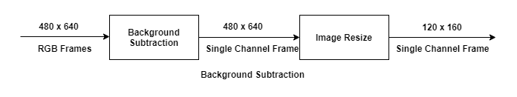
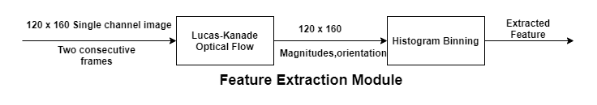
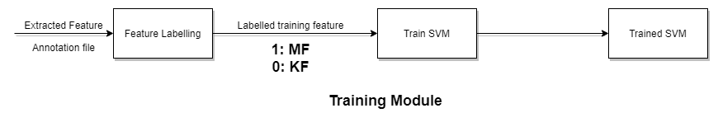
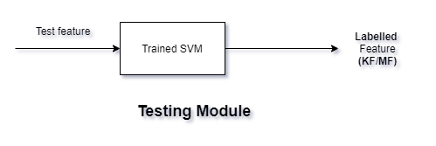
Workflow

Slide 9
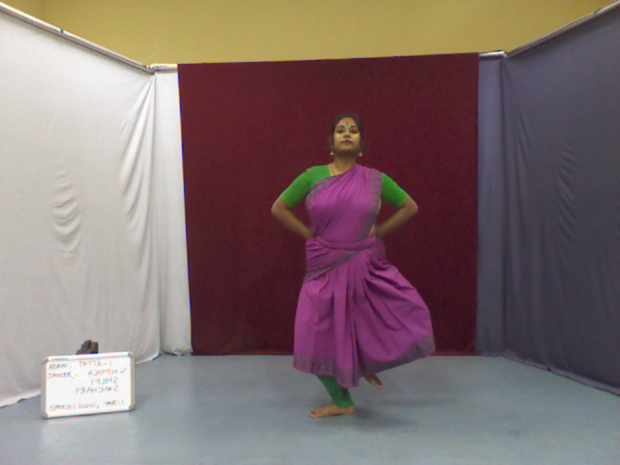
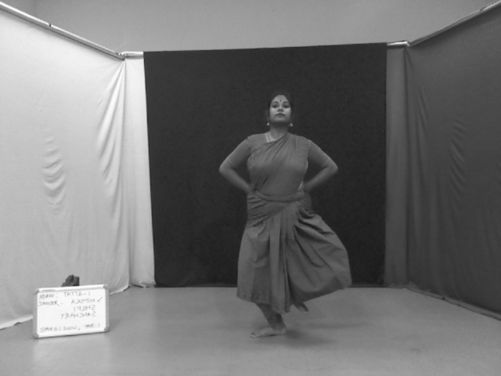
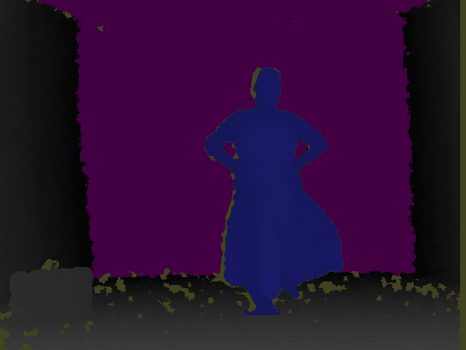
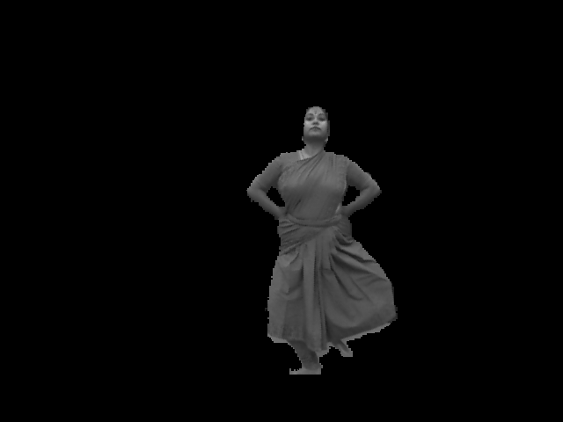
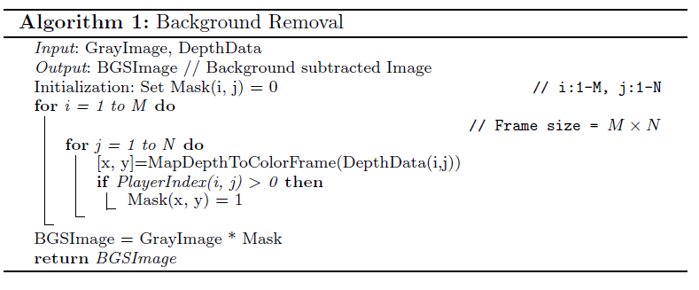
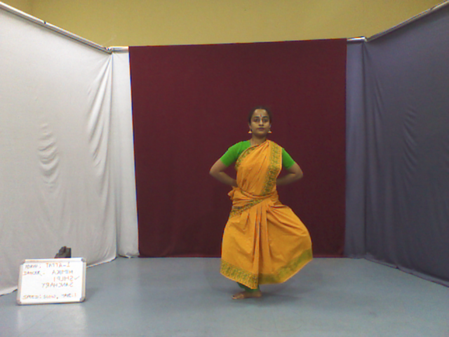
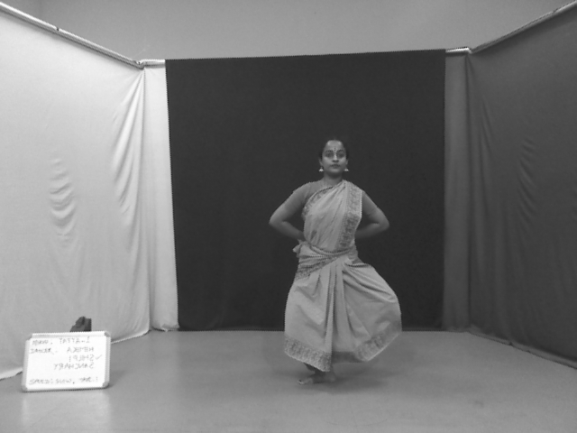
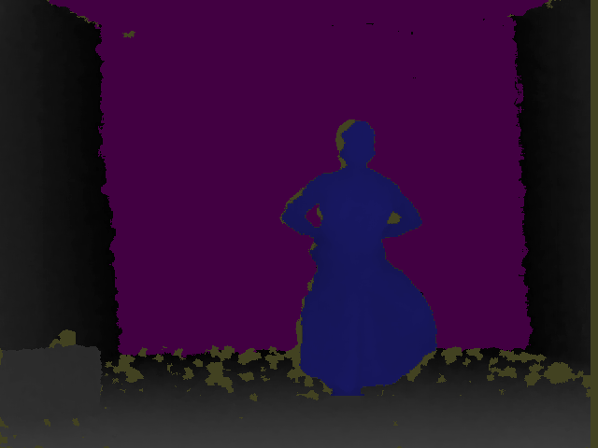
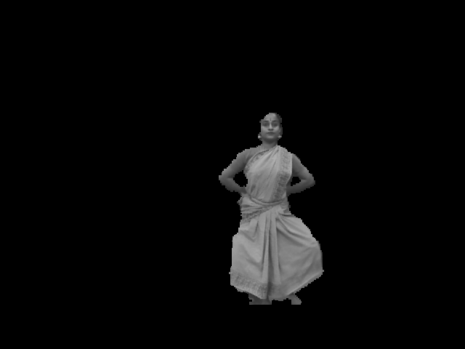
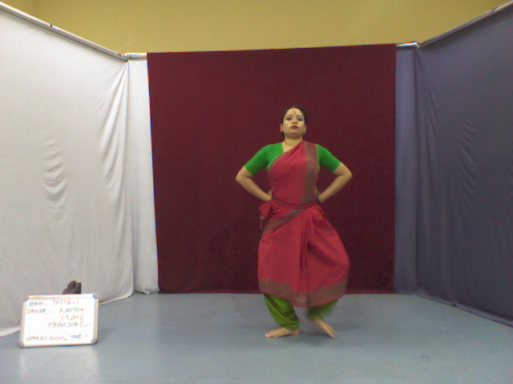
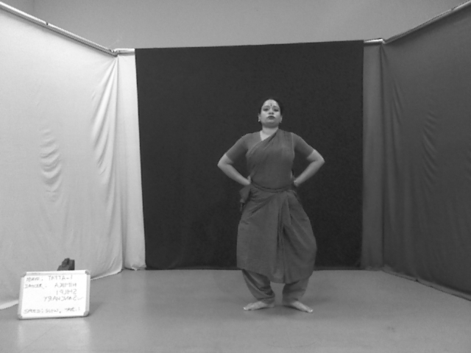
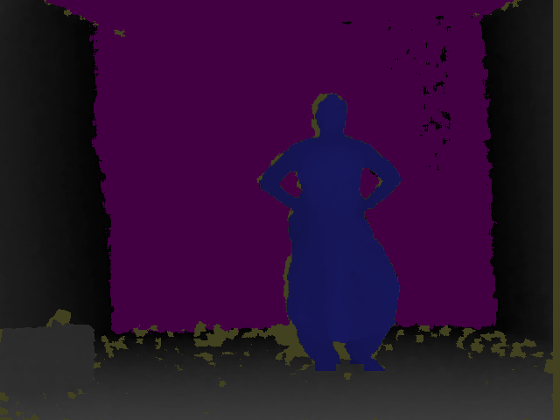
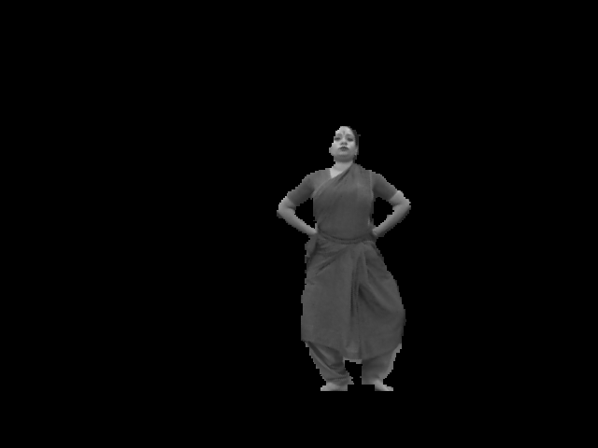
Preprocessing
Background Subtraction Flow and Algorithm
480 x 640 RGB Input Image^{[1]}
Tatta -> Variation 1 -> Dancer 1
480 x 640 Grey Frame
Tatta -> Variation 1 -> Dancer 1
480 x 640 Depth Frame^{[2]}
Tatta -> Variation 1 -> Dancer 1
480 x 640 Single Channel Image^{[3]}
Tatta -> Variation 1 -> Dancer 1
480 x 640 RGB Input Image^{[4]}
Tatta -> Variation 1 -> Dancer 2
480 x 640 Grey Frame
Tatta -> Variation 1 -> Dancer 2
480 x 640 Depth Frame^{[5]}
Tatta -> Variation 1 -> Dancer 2
480 x 640 Single Channel Image^{[6]}
Tatta -> Variation 1 -> Dancer 2
480 x 640 RGB Input Image^{[7]}
Tatta -> Variation 1 -> Dancer 3
480 x 640 Grey Frame
Tatta -> Variation 1 -> Dancer 3
480 x 640 Depth Frame^{[8]}
Tatta -> Variation 1 -> Dancer 3
480 x 640 Single Channel Image^{[9]}
Tatta -> Variation 1 -> Dancer 3
color_USB-VID_045E&PID_02BF-0000000000000000_261.png
depth_USB-VID_045E&PID_02BF-0000000000000000_261.png
USB-VID_045E&PID_02BF-0000000000000000_261.png
color_USB-VID_045E&PID_02BF-0000000000000000_205.png
depth_color_USB-VID_045E&PID_02BF-0000000000000000_205.png
USB-VID_045E&PID_02BF-0000000000000000_205.png
color_USB-VID_045E&PID_02BF-0000000000000000_149.png
depth_color_USB-VID_045E&PID_02BF-0000000000000000_149.png
USB-VID_045E&PID_02BF-0000000000000000_149.png

Slide 10
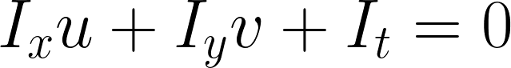
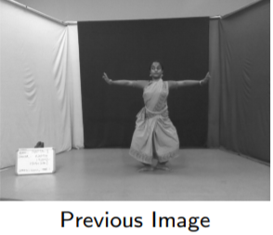
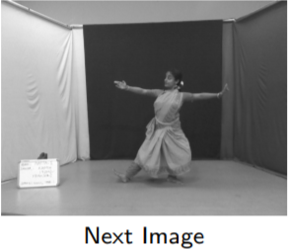
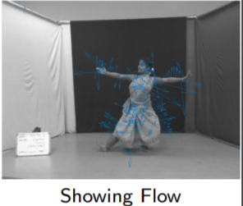
Estimate Optical Flow: Lucas-Kanade Method^{[1]}
opticalFlowLK^{[2]}: Finds an optical flow for each prev pixel using the Lucas-Kanade Method.
Input: Two consecutive images
Output: Optical flow / velocity vector (Vx, Vy) = (u, v) for each pixel
Assumption: Brightness/ Intensity doesn’t change with time. So, I(x, y, t) = I(x + u, y + v, t)
Ix, Iy, and It are the spatiotemporal image brightness derivatives.
u is the horizontal velocity vector.
v is the vertical velocity vector.
Barron, J. L., D. J. Fleet, S. S. Beauchemin, and T. A. Burkitt. “ Performance of optical flow techniques.” In Proceedings of the IEEE Conference on Computer Vision and Pattern Recognition (CVPR),236-242. Champaign, IL: CVPR, 1992.
https://in.mathworks.com/help/vision/ref/opticalflowlk.html#d120e88677

Slide 11
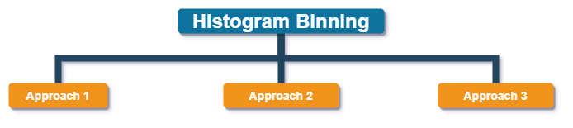
Histogram Binning
Global Histogram using only magnitudes of optical flow
Creates a histogram taking image optical flow, Sort into numbins equally spaced bins.
numbins (Number of bins) = 9
Input: Vector X of size 19200 (120 x 160 )
Output: Feature vector of size 9
Sample Feature Vector:
[18611 ,173 ,142 ,115 ,71 ,50 ,29 ,4 ,5 ]
Global Histogram using magnitudes and Orientation of optical flow
Create a histogram of optical flow (HOOF) of image, based on respective weightage of magnitude wrt orientations and create bins.
numbins (Number of bins) = 9
Image size = 120 x 160
Input: magnitudes, orientations of size 19200
Output: Feature vector of size 9
Sample Feature Vector:
[68.98, 5.93, 0, 0, 0, 0, 0, 0,21.13]
Fractional Histogram Binning using magnitudes and Orientation of optical flow taken over 8 x 8 cell
Create a local histogram of optical flow over
8 x 8 cell of image, and concatenate them.
numbins (Number of bins) = 9
Image size = 120 x 160
Input: magnitudes, orientations
Output: Feature vector of size 9576

Slide 12
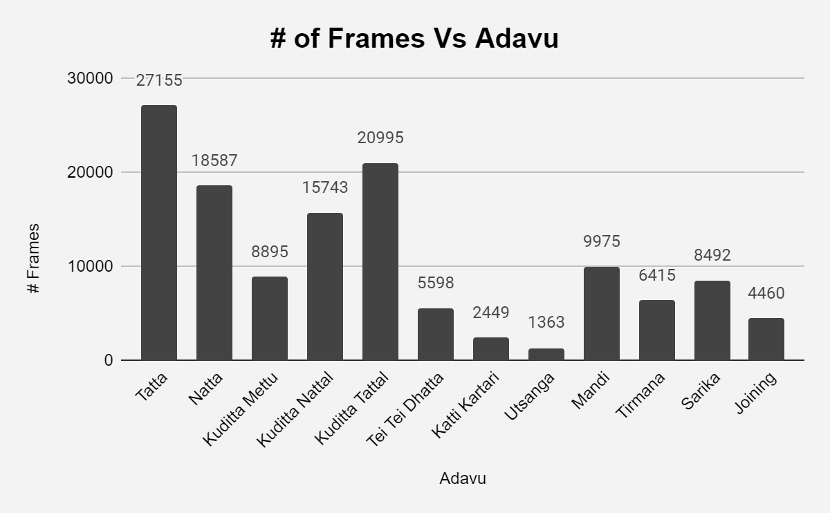
Dataset Introduction
ADAVU | VARIATIONS | # Dancers | # Videos | # Frames | # Motion Frame | # Key Frame
Tatta | 8 | 3 | 24 | 27155 | 12531 | 14624
Natta | 8 | 3 | 24 | 18587 | 9546 | 9041
Kuditta Mettu | 4 | 3 | 12 | 8895 | 4325 | 4570
Kuditta Nattal | 6 | 3 | 18 | 15743 | 9816 | 5927
Kuditta Tattal | 5 | 3 | 15 | 20995 | 13424 | 7571
Tei Tei Dhatta | 3 | 3 | 9 | 5598 | 4336 | 1262
Katti Kartari | 1 | 3 | 3 | 2449 | 1747 | 702
Utsanga | 1 | 3 | 3 | 1363 | 1085 | 278
Mandi | 2 | 3 | 6 | 9975 | 5449 | 4526
Tirmana | 3 | 3 | 9 | 6415 | 4181 | 2234
Sarika | 4 | 3 | 12 | 8492 | 5662 | 2830
Joining | 3 | 2 | 6 | 4460 | 3110 | 1350
Total | 48 |  | 141 | 130127 | 75212 | 54915
Video recorded using Kinect V1.0 in 30 fps
We use RGB stream and converted them to Grey scale

Slide 13
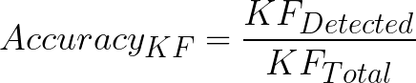
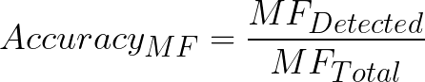
Evaluation metrics
where Accuracy_{KF} : Accuracy of KeyFrame
KF_{Detected} : Number of detected KeyFrame
KF_{Total} : Total Number of KeyFrame
where Accuracy_{MF} : Accuracy of Motion Frame
MF_{Detected} : Number of detected Motion Frame
MF_{Total} : Total Number of Motion Frame

Slide 14
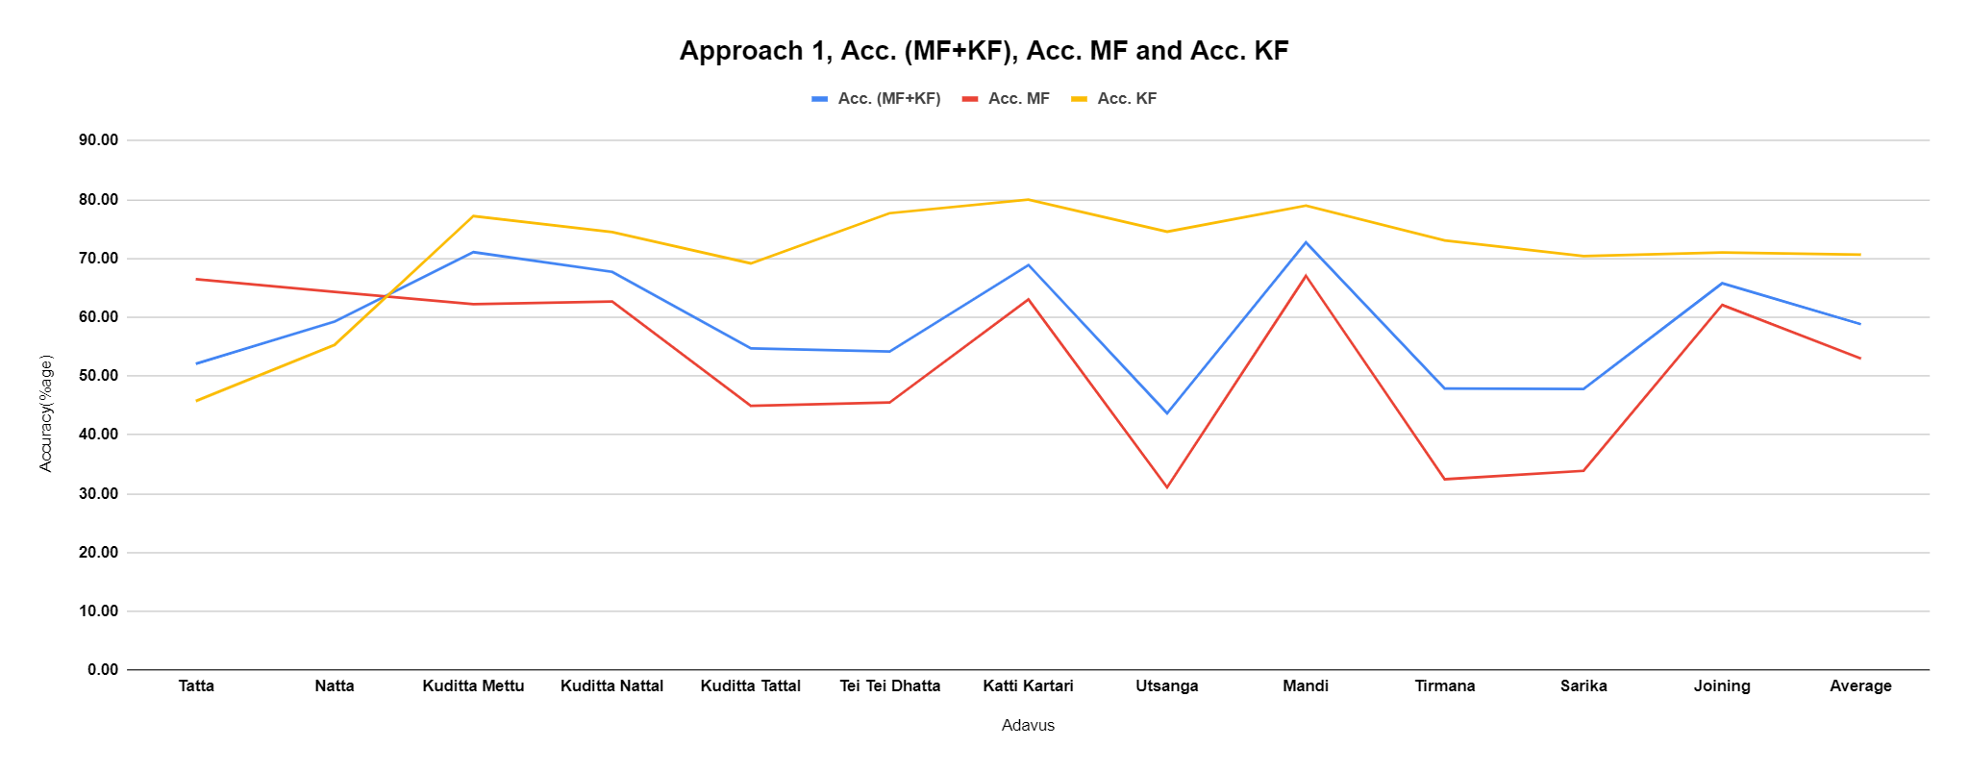
Results Approach 1: Global Histogram using only magnitudes of optical flow
Adavus | Acc. (MF+KF) | Acc. MF | Acc. KF | precision_mf | precision_kf | f1_mf | f1_kf
Tatta | 52.10 | 66.48 | 45.78 | 35.01 | 75.66 | 45.86 | 57.04
Natta | 59.26 | 64.30 | 55.32 | 52.92 | 66.49 | 58.06 | 60.39
Kuditta Mettu | 71.07 | 62.24 | 77.19 | 65.45 | 74.66 | 63.81 | 75.90
Kuditta Nattal | 67.73 | 62.67 | 74.47 | 76.54 | 60.01 | 68.91 | 66.46
Kuditta Tattal | 54.72 | 44.95 | 69.16 | 68.30 | 45.93 | 54.22 | 55.20
Tei Tei Dhatta | 54.19 | 45.51 | 77.69 | 84.66 | 34.51 | 59.20 | 47.79
Katti Kartari | 68.88 | 63.04 | 80.00 | 85.71 | 53.20 | 72.65 | 63.91
Utsanga | 43.68 | 31.11 | 74.55 | 75.00 | 30.60 | 43.98 | 43.39
Mandi | 72.75 | 67.04 | 78.98 | 77.67 | 68.72 | 71.97 | 73.49
Tirmana | 47.90 | 32.49 | 73.04 | 66.28 | 39.87 | 43.60 | 51.59
Sarika | 47.81 | 33.91 | 70.39 | 65.06 | 39.58 | 44.59 | 50.67
Joining | 65.79 | 62.11 | 71.00 | 75.16 | 57.01 | 68.01 | 63.25
Average | 58.82 | 52.99 | 70.63 | 68.98 | 53.85 | 57.91 | 59.09
Accuracy in approach 1 is inheritedly distributed.
There may be complex descriptor of KF in Tatta, so there is low accuracy for it.
There may cases where Tatta feature could not be represented uniformly in approach 1. As, we are using the only magnitude for histogram binning as shown in the figure.

Slide 15
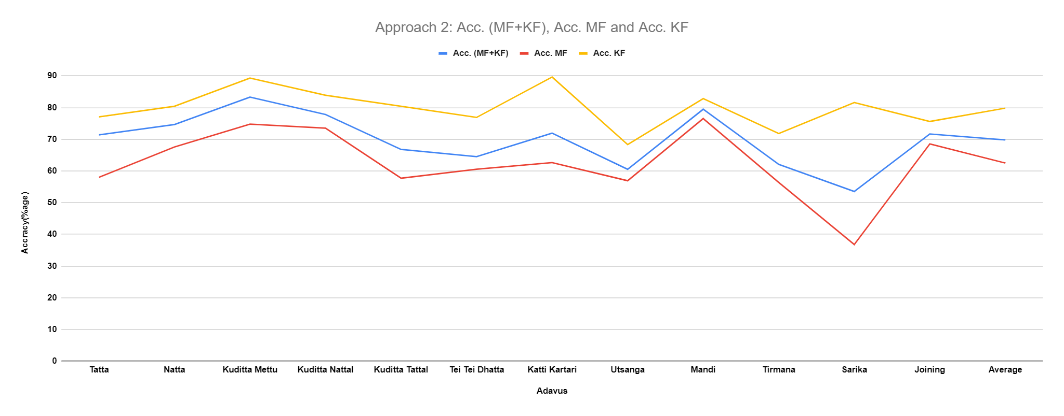
Results Approach 2: Global Histogram using magnitudes and Orientation of optical flow
Adavus | Acc. (MF+KF) | Acc. MF | Acc. KF | precision_mf | precision_kf | f1_mf | f1_kf
Tatta | 71.36 | 58.02 | 77.05 | 51.86 | 81.16 | 54.77 | 79.05
Natta | 74.63 | 67.57 | 80.42 | 73.85 | 75.19 | 70.57 | 77.71
Kuditta Mettu | 83.3 | 74.76 | 89.31 | 83.1 | 83.42 | 78.71 | 86.26
Kuditta Nattal | 77.82 | 73.5 | 83.89 | 86.5 | 69.27 | 79.47 | 75.88
Kuditta Tattal | 66.8 | 57.72 | 80.4 | 81.54 | 55.92 | 67.59 | 65.96
Tei Tei Dhatta | 64.52 | 60.57 | 76.89 | 89.14 | 38.36 | 72.13 | 51.18
Katti Kartari | 71.94 | 62.65 | 89.63 | 92 | 55.76 | 74.54 | 68.75
Utsanga | 60.53 | 56.92 | 68.33 | 79.57 | 42.27 | 66.37 | 52.23
Mandi | 79.47 | 76.53 | 82.84 | 83.66 | 75.47 | 79.94 | 78.98
Tirmana | 62.08 | 56.39 | 71.8 | 77.33 | 49.11 | 65.22 | 58.33
Sarika | 53.54 | 36.79 | 81.59 | 76.98 | 43.55 | 49.78 | 56.78
Joining | 71.65 | 68.51 | 75.61 | 77.99 | 65.56 | 72.94 | 70.23
Average | 69.80 | 62.49 | 79.81 | 79.46 | 61.25 | 69.34 | 68.45

Slide 16
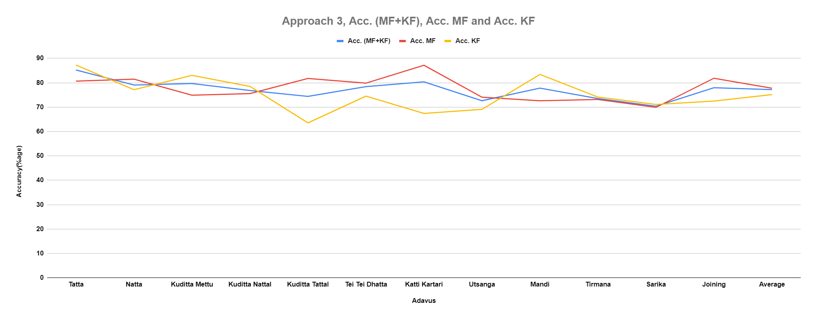
Results Approach 3: Fractional Histogram Binning using magnitudes and Orientation of optical flow taken over 8 x 8 cell
Adavus | Acc. (MF+KF) | Acc. MF | Acc. KF | precision_mf | precision_kf | recall_mf | recall_kf | f1_mf | f1_kf
Tatta | 85.23 | 80.65 | 87.25 | 73.53 | 91.12 | 80.65 | 87.25 | 76.92 | 89.14
Natta | 79.05 | 81.48 | 77.16 | 73.59 | 84.21 | 81.48 | 77.16 | 77.33 | 80.53
Kuditta Mettu | 79.68 | 74.88 | 83 | 75.36 | 82.64 | 74.88 | 83 | 75.12 | 82.82
Kuditta Nattal | 76.82 | 75.54 | 78.49 | 82.06 | 71.12 | 75.54 | 78.49 | 78.67 | 74.62
Kuditta Tattal | 74.41 | 81.76 | 63.55 | 76.84 | 70.21 | 81.76 | 63.55 | 79.22 | 66.72
Tei Tei Dhatta | 78.39 | 79.82 | 74.5 | 89.44 | 57.72 | 79.82 | 74.5 | 84.36 | 65.04
Katti Kartari | 80.36 | 87.16 | 67.41 | 83.58 | 73.39 | 87.16 | 67.41 | 85.33 | 70.27
Utsanga | 72.63 | 74.07 | 69.09 | 85.47 | 52.05 | 74.07 | 69.09 | 79.37 | 59.38
Mandi | 77.78 | 72.62 | 83.41 | 82.68 | 73.63 | 72.62 | 83.41 | 77.32 | 78.22
Tirmana | 73.49 | 73.12 | 74.1 | 82.52 | 62.24 | 73.12 | 74.1 | 77.54 | 67.65
Sarika | 70.36 | 69.9 | 71.1 | 79.73 | 59.23 | 69.9 | 71.1 | 74.49 | 64.63
Joining | 77.97 | 81.84 | 72.49 | 80.78 | 73.86 | 81.84 | 72.49 | 81.31 | 73.17
Average | 77.18 | 77.74 | 75.13 | 80.47 | 70.95 | 77.74 | 75.13 | 78.92 | 72.68
Approach 3 is better because it does not deviate for Accuracy_{MF+KF}, Accuracy_{MF} & Accuracy_{KF} as compare to approach 1 and 2.
It could be observed through previous two figures that accuracies non-uniform in approach 1 and 2.
In approach 3, It is observed that Accuracy_{MF+KF}, Accuracy_{MF} & Accuracy_{KF} for Utsanga does not deviate too much as compared to approach 1.

Slide 17
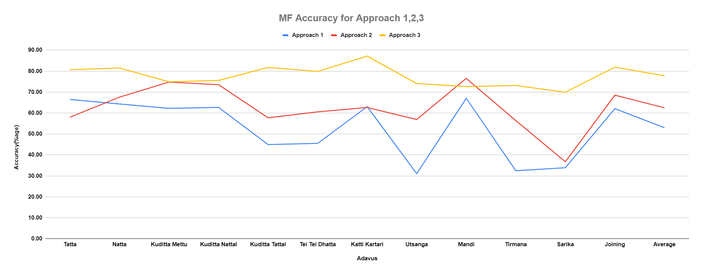
MF Accuracy for Approach 1,2,3
 | Accuracy
Adavus | Approach 1 | Approach 2 | Approach 3
Tatta | 66.48 | 58.02 | 80.65
Natta | 64.30 | 67.57 | 81.48
Kuditta Mettu | 62.24 | 74.76 | 74.88
Kuditta Nattal | 62.67 | 73.50 | 75.54
Kuditta Tattal | 44.95 | 57.72 | 81.76
Tei Tei Dhatta | 45.51 | 60.57 | 79.82
Katti Kartari | 63.04 | 62.65 | 87.16
Utsanga | 31.11 | 56.92 | 74.07
Mandi | 67.04 | 76.53 | 72.62
Tirmana | 32.49 | 56.39 | 73.12
Sarika | 33.91 | 36.79 | 69.90
Joining | 62.11 | 68.51 | 81.84
Average | 52.99 | 62.49 | 77.74
For detection of MF from set of adavus frame:
Approach 3 is the best approach among the three methods we have tried. Approach 1 is the worst among all methods available.
As we know, approach 1 is the simplest. We can see in the figure that Accuracy_{MF} for approach 3 is higher than Accuracy_{MF}for approach 1 and approach 2.
Approach 3 has fine detail about optical flow, and it is normalized for every cell so it perform better than others.
We could also observe that approach 1 and 2 are performing inadequate but approach 3 performance was good, specially in case teitei dhatta adavu, katti kartari adavu, utsanga adavu and sarika adavu. It could be seen that sarika adavu accuracy gap is wide.
Overall approach 3 perform better than method 1 and 2.

Slide 18
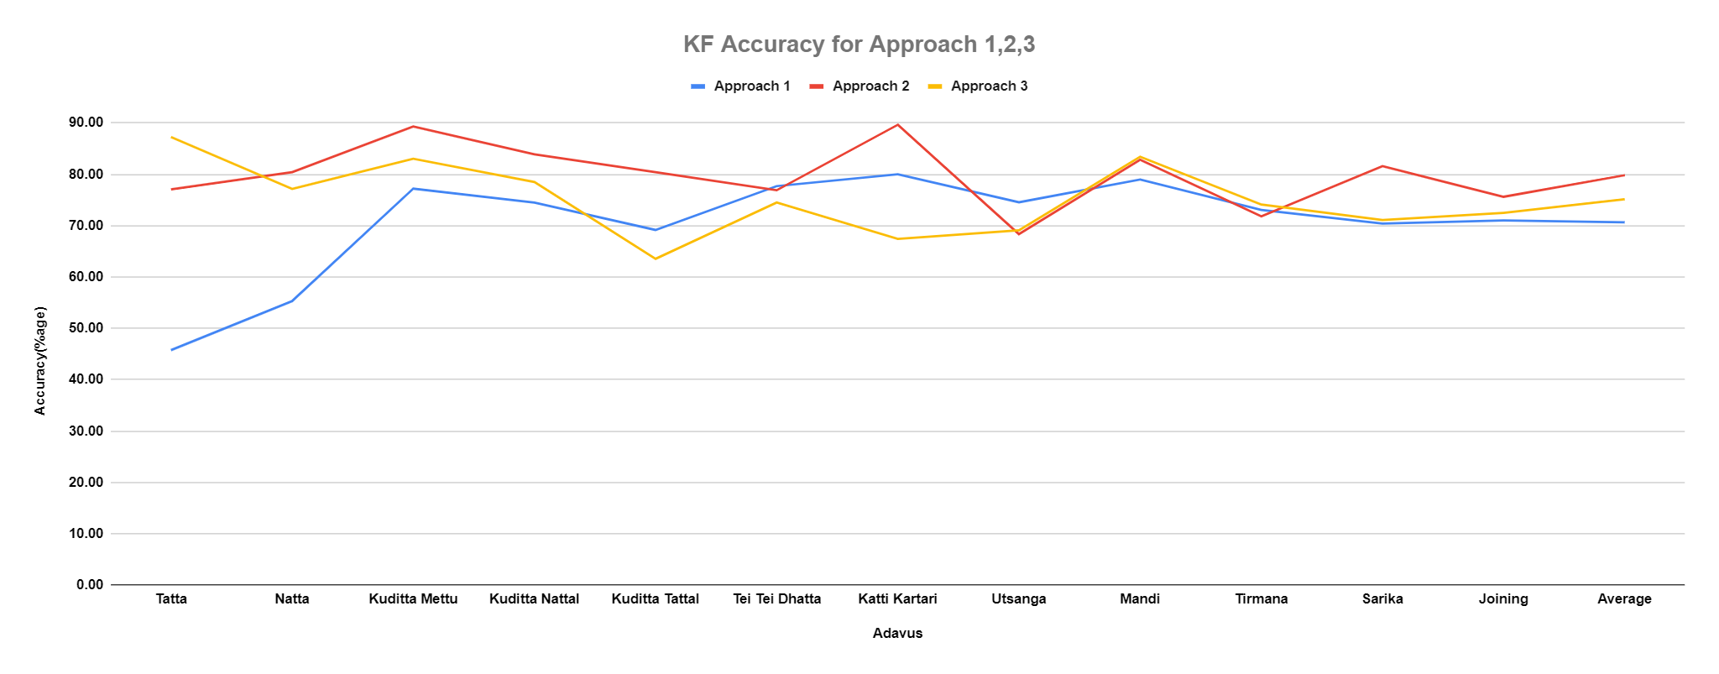
KF Accuracy for Approach 1,2,3
 | Accuracy
Adavus | Approach 1 | Approach 2 | Approach 3
Tatta | 45.78 | 77.05 | 87.25
Natta | 55.32 | 80.42 | 77.16
Kuditta Mettu | 77.19 | 89.31 | 83.00
Kuditta Nattal | 74.47 | 83.89 | 78.49
Kuditta Tattal | 69.16 | 80.40 | 63.55
Tei Tei Dhatta | 77.69 | 76.89 | 74.50
Katti Kartari | 80.00 | 89.63 | 67.41
Utsanga | 74.55 | 68.33 | 69.09
Mandi | 78.98 | 82.84 | 83.41
Tirmana | 73.04 | 71.80 | 74.10
Sarika | 70.39 | 81.59 | 71.10
Joining | 71.00 | 75.61 | 72.49
Average | 70.63 | 79.81 | 75.13
Analysing in the figure KF Accuracy for approach 1, 2, 3. We can say that when Approach 2 and 3 is used, then accuracy improved for Tatta as compared to approach 1.(see in figure Approach 1, Acc._{MF+KF}, Acc._{MF} and Acc._{KF}.

Slide 19
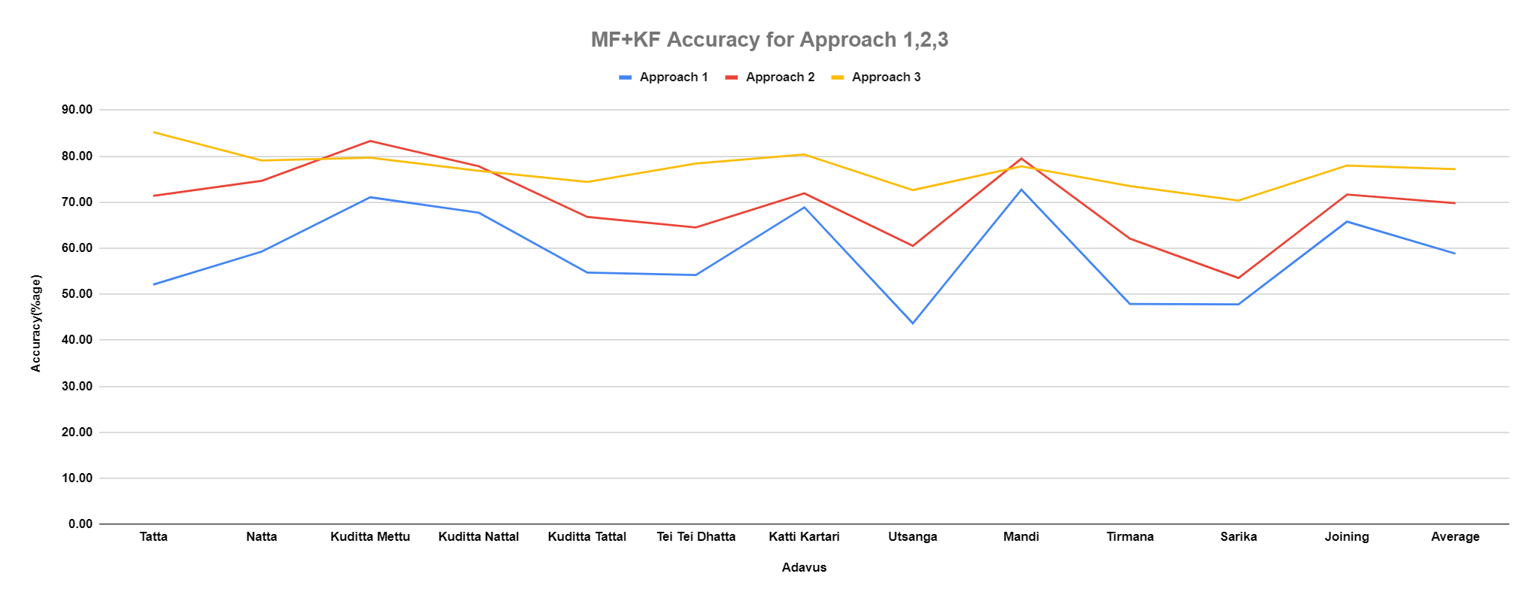
Accuracy_{MF+KF} for Approach 1,2,3
 | Accuracy
Adavus | Approach 1 | Approach 2 | Approach 3
Tatta | 52.10 | 71.36 | 85.23
Natta | 59.26 | 74.63 | 79.05
Kuditta Mettu | 71.07 | 83.30 | 79.68
Kuditta Nattal | 67.73 | 77.82 | 76.82
Kuditta Tattal | 54.72 | 66.80 | 74.41
Tei Tei Dhatta | 54.19 | 64.52 | 78.39
Katti Kartari | 68.88 | 71.94 | 80.36
Utsanga | 43.68 | 60.53 | 72.63
Mandi | 72.75 | 79.47 | 77.78
Tirmana | 47.90 | 62.08 | 73.49
Sarika | 47.81 | 53.54 | 70.36
Joining | 65.79 | 71.65 | 77.97
Average | 58.82 | 69.80 | 77.18
Accuracy_{MF+KF} is the weighted average of Accuracy_{MF} and Accuracy_{KF}. So, obivoulsy it depends on the number_{MF} and number_{KF} presents in each adavus.

Slide 20
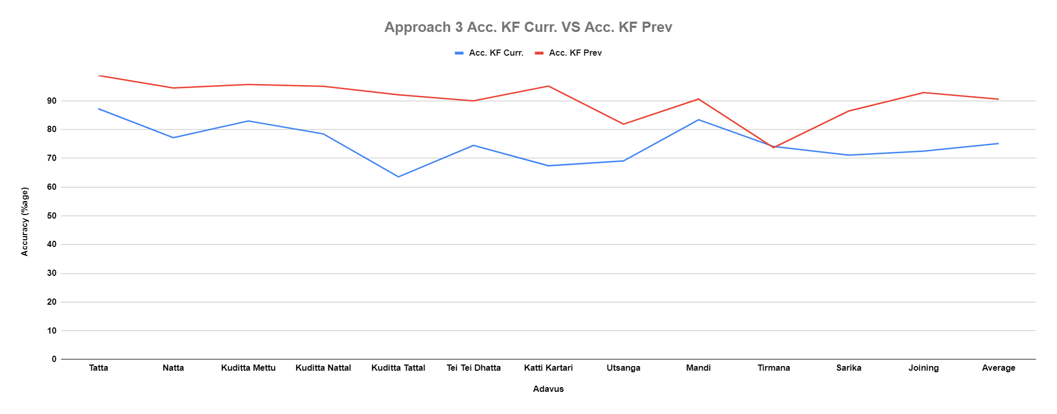
MF+KF Accuracy for Approach 1,2,3
Adavus | Acc. KF Curr. | Acc. KF Prev
Tatta | 87.25 | 98.813
Natta | 77.16 | 94.485
Kuditta Mettu | 83 | 95.67
Kuditta Nattal | 78.49 | 95.054
Kuditta Tattal | 63.55 | 92.092
Tei Tei Dhatta | 74.5 | 89.971
Katti Kartari | 67.41 | 95.118
Utsanga | 69.09 | 81.871
Mandi | 83.41 | 90.614
Tirmana | 74.1 | 73.718
Sarika | 71.1 | 86.442
Joining | 72.49 | 92.846
Average | 75.13 | 90.56
No doubt we have computed accuracy for both MF and KF. But our main objective is to detect MF and hence tried to optimize MF accuracy.
Here, I have compared KF accuracy with “segmentation of Bharatanatyam dance video: detection of keyframe” as done in the paper by Himadri.^{[1]}
Himadri Bhuyan, PhD work, IIT Kharagpur, " segmentation of bharatanatyam dance video: detection of key frame " dance.

Slide 21
ACKNOWLEDGEMENT
The authors appreciate the support from Himadri B.G.S. Bhuyan and Prof. Partha Pratim Das
Matlab community and its software

Slide 22
REFERENCES
Aich, A., Mallick, T., Bhuyan, H.B., Das, P.P. and Majumdar, A.K., 2017, December. Nrityaguru: A dance tutoring system for bharatanatyam using kinect. In National Conference on Computer Vision, Pattern Recognition, Image Processing, and Graphics (pp. 481-493). Springer, Singapore.
Matthew Cooper, Ting Liu, and Eleanor Rieffel. Video segmentation via temporal pattern classification. IEEE transactions on multimedia, 9(3):610–618, 2007.
Rizwan Chaudhry, Avinash Ravichandran, Gregory Hager, and Ren´e Vidal. Histograms of oriented optical flow and binet-cauchy kernels on nonlinear dynamical systems for the recognition of human actions. In 2009 IEEE Conference on Computer Vision and Pattern Recognition, pages 1932–1939. IEEE, 2009
Ivan Laptev. On space-time interest points. International journal of computer vision, 64(2-3):107–123, 2005
Alexei A Efros, Alexander C Berg, Greg Mori, and Jitendra Malik. Recognizing action at a distance. In null, page 726. IEEE, 2003.
Guozhu Liu at el. showed Key Frame Extraction method from compressed MPEG video data. It helps in reducing Video processing time significantly.It helps in video segmentation and Keyframe extraction. [Liu and Zhao, 2010].
Koneˇcn´y, J. and Hagara, M used RGB, depth images and combine appearance (Histograms of Oriented Gradients) and motion descriptors (Histogram of optical flow) for parallel temporal segmentation and recognition. [Koneˇcn`y and Hagara, 2014].
Tran et al. present an optical flow and shape-based approach that uses separate histograms for the horizontal and vertical components of the optical flow as well as the contour of the person as a motion descriptor. [Tran and Sorokin, 2008]

Slide 23
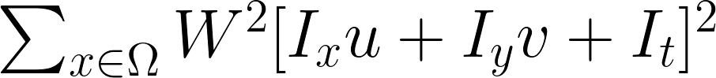
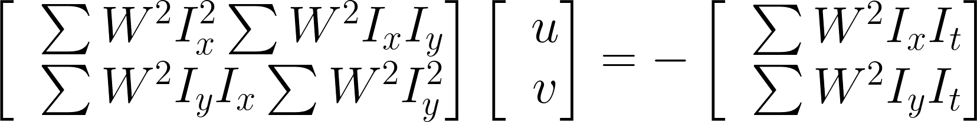
Estimate Optical Flow: Lucas-Kanade Method^{[1]}
To compute the optical flow between two images, you must solve this optical flow constraint equation
Ix, Iy, and It are the spatiotemporal image brightness derivatives.
u is the horizontal optical flow.
v is the vertical optical flow.
Solve the optical flow constraint equation for u and v
Lucas-Kanade method divides the original image into smaller sections & assumes a constant velocity in each section.
Performs a weighted, least-square fit of the optical flow constraint equation to a constant model for [u v]^{T} in each section Ω. The method achieves this fit by minimizing following equation:
W is a window function that emphasizes the constraints at the center of each section. The solution to the minimization problem is
https://in.mathworks.com/help/vision/ref/opticalflowlk.html#d120e88677

